Slide 1

Airbnb Listings Analysis
Uncovering insights from Airbnb data using Python, MySQL, and Power BI.

Slide 2
Project Objective
Analyze Airbnb listing data to reveal key insights into pricing trends, availability, host performance, and location-based patterns. This project showcases a complete data analytics workflow.
Pricing Trends
Availability
Understand market dynamics.
Identify booking patterns.
Host Performance
Location Patterns
Evaluate top hosts.
Discover high-value areas.

Slide 3





Tech Stack Used
Data Processing
Python (Pandas, NumPy)
Database
MySQL
Visualization
Power BI
Data Source
Airbnb Listings Dataset

Slide 4





End-to-End Project Workflow
1. Data Collection
Gathering comprehensive Airbnb listing data.
2. Data Cleaning
Preprocessing with Python for accuracy.
3. Data Storage
Managing data in MySQL.
4. Data Analysis
Extracting insights using SQL & Python.
5. Visualization
Interactive dashboards in Power BI.

Slide 5


Data Cleaning & Preprocessing
Using Python (Pandas & NumPy) to transform raw data into an analysis-ready dataset.
Removed duplicate listings.
Handled missing values.
Converted price fields to numeric.
Standardized categorical columns.
Performed feature engineering (e.g., price per night).
Outcome: Clean, analysis-ready dataset.

Slide 6

Data Storage & Management
Structured tables in MySQL for efficient data management and querying.
Created structured tables.
Defined data types and constraints.
Loaded cleaned data from Python.
Performed SQL queries for average price, room type distribution, and availability trends.
Outcome: Optimized relational database for analytics.

Slide 7
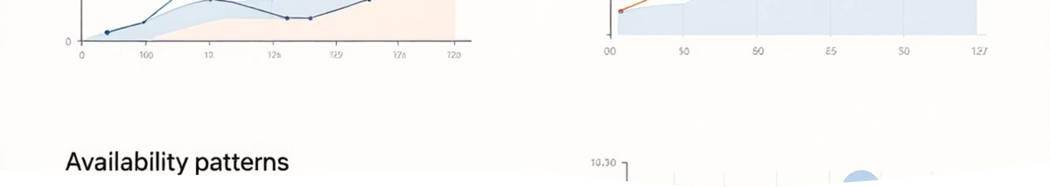



Data Analysis: SQL + Python
Extracting business-ready insights through aggregations, filtering, and exploratory data analysis.
SQL Queries
Python EDA
Aggregations, filtering, and joins for specific data points.
Exploratory analysis of price distribution, room types, and host activity.
Outcome: Business-ready insights extracted from raw data.

Slide 8


Data Visualization: Power BI Dashboard
An interactive Power BI dashboard connected to MySQL, offering actionable insights.
Dashboard Features
Average Price by Neighborhood
1
Room Type Distribution
Availability Trends
Reviews vs Pricing
Power BI Enhancements
2
Slicers for city, room type, price
KPI cards for key metrics
Interactive drill-downs
Outcome: Actionable, decision-ready dashboard.

Slide 9
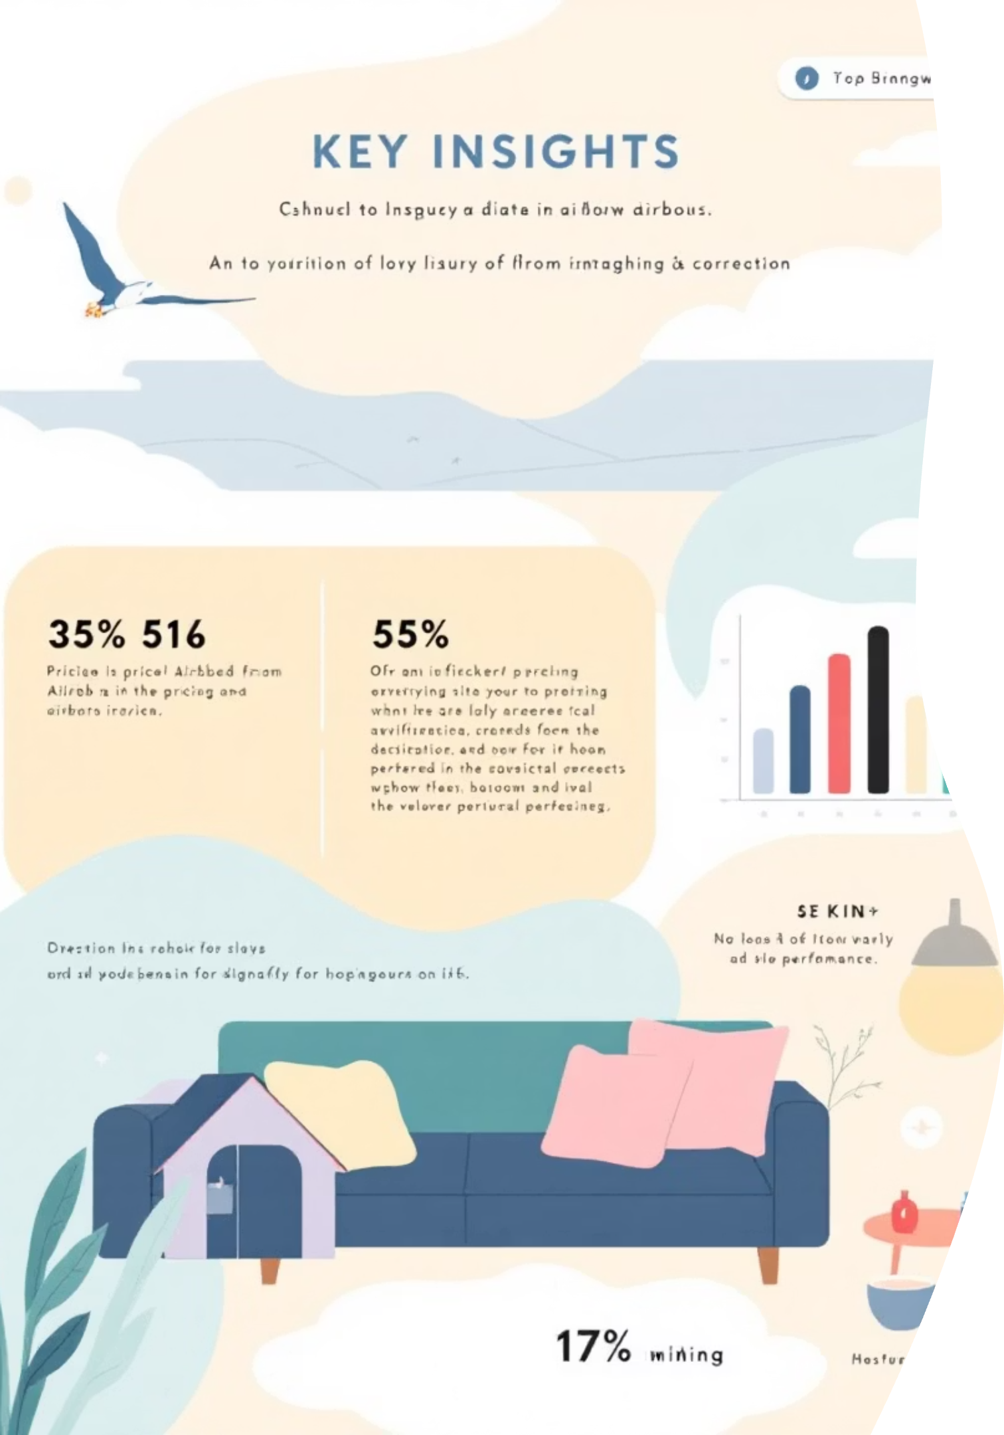
Key Insights Derived
1
Pricing Dynamics
Certain neighborhoods command higher prices; entire homes are significantly more expensive.
2
Availability vs. Price
High availability doesn't always correlate with higher pricing.
3
Host Dominance
Hosts with multiple listings dominate high-revenue segments.
4
Review Optimization
Listings with better reviews tend to have optimized pricing strategies.

Slide 10

Business Impact & Skills Demonstrated
Business Impact
Skills Demonstrated
Helps hosts optimize pricing.
Data Cleaning & Transformation
Identifies profitable locations for investors.
SQL Query Optimization
Assists travelers in understanding market trends.
Relational Database Design
Power BI Dashboard Design
End-to-End Data Analytics Workflow

